Slide 1
Psychological Advertising: Exploring User Psychology for Click Prediction in Sponsored Search
Date: 2014/03/25
Author: Taifeng Wang, Jiang Bian, Shusen Liu*, Yuyu Zhang*, Tie-Yan Liu
Source: KDD’ 13
Advisor: Jia-Ling Koh
Speaker: Sz-Han Wang

Slide 2
Outline
Introduction
Method
Experiments
Conclusion

Slide 3
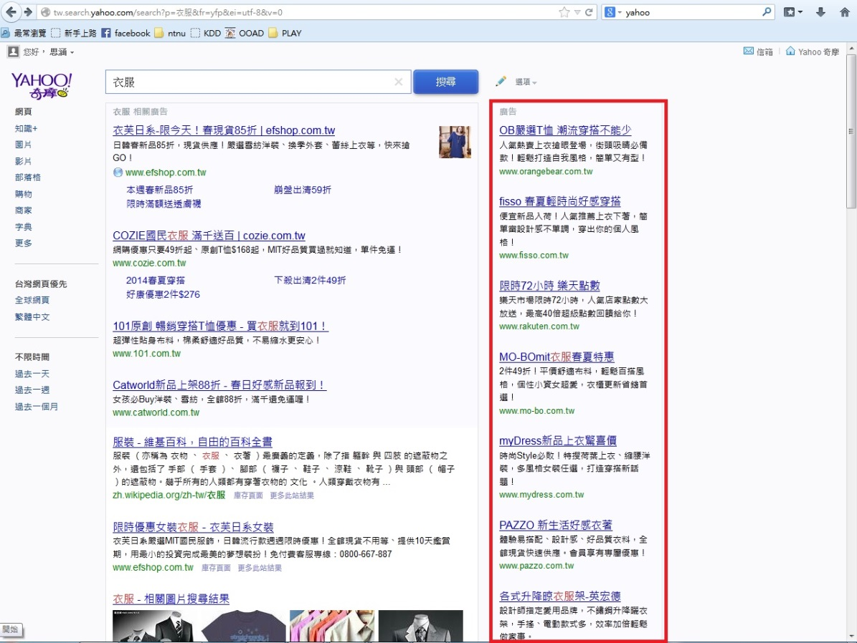
Introduction
As an online advertising system, sponsored search has been one of the most important business models for commercial Web search engines.
Sponsored search

Slide 4
Introduction
A sponsored search consists of a couple of technical components
query-to-ad matching
click prediction for matched ads
filtration of the ads according to thresholds for relevance and click probability,
auction to determine the ranking, placement, and pricing of the remaining ads
Employ a machine learning model to predict the probability that a user clicks an ad
Historical click information
Relevance information

Slide 5
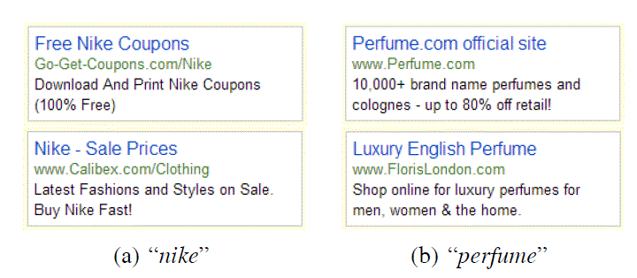
Introduction
In order for more accurate click prediction, we need to examine why users click
Propose modeling user psychological desire for both ads and users based on textual patterns in sponsored search according to Maslow’s desire theory

Slide 6
Outline
Introduction
Method
Experiments
Conclusion

Slide 7
Framework
DATA ANALYSIS ON USER PSYCHOLOGICAL DESIRES
1. Consumer Decision Making Process
2. Effects of User Psychological Desire
DISCOVERING USERS PSYCHOLOGICAL DESIRE FROM ADS
1. Mining User Desire Patterns
2. Hierarchy of User Psychological Desire
CLICK PREDICTION MODELING
1. Maximum-Entropy Modeling
2. Integrating User Psychological Desires into Click Prediction

Slide 8
DATA ANALYSIS ON USER PSYCHOLOGICAL DESIRES
Consumer Decision Making Process
According to the decision making is affected by three effects:
contextual (environmental effects)
thought-based (pricing discount, deliver time limitation, etc.,)
feeling-based (brand preference, trustworthiness, luxury seeking, etc.,).
Since consumer psychological desires are diverse, it is naturally to organize them into a hierarchy to model consumer behaviors in a more effective way.

Slide 9
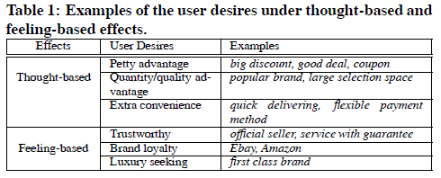
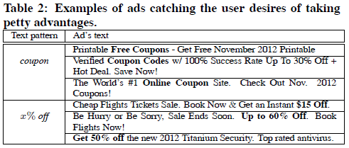
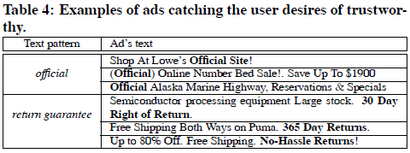
DATA ANALYSIS ON USER PSYCHOLOGICAL DESIRES
Effects of User Psychological Desire

Slide 10
DATA ANALYSIS ON USER PSYCHOLOGICAL DESIRES
Effects of User Psychological Desire
User psychological desire has been well utilized by advertisers to lead users to click more on their ads.

Slide 11
DISCOVERING USERS PSYCHOLOGICAL DESIRE FROM ADS
3 principle:
The text content should cover enough volume in real ad traffic
Similar content can reflect the specific same desire can be organized in a cluster of text phrases. call one cluster a user desire pattern. Ex: coupon, can be “coupon code”, “get coupon”, “free coupons” .
Text content from experienced advertisers will be highly possible to form useful desire patterns.

Slide 12
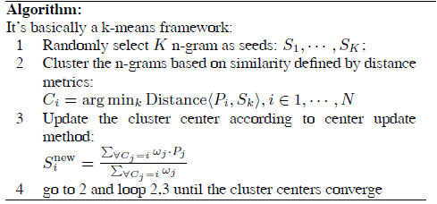
DISCOVERING USERS PSYCHOLOGICAL DESIRE FROM ADS
Mining User Desire Patterns
Step 1: Cleaning up content targeting for relevance
Query: cheap car
Step 2: Finding n-grams with high frequency
Step 3: pattern generalization
K=300

Slide 13
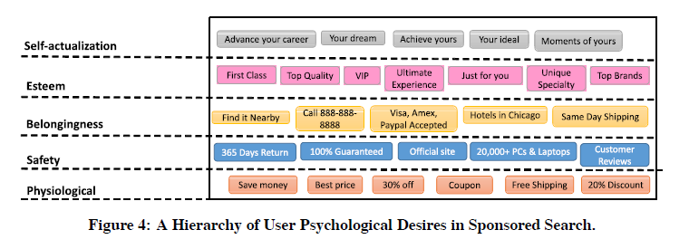
DISCOVERING USERS PSYCHOLOGICAL DESIRE FROM ADS
Hierarchy of User Psychological Desire
Organize extracted general desires into a hierarchy of user psychological desires according to Maslow’s hierarchy of needs

Slide 14
CLICK PREDICTION MODELING
Maximum-Entropy Modeling
formulate click prediction in sponsored search as a supervised learning problem
training samples, Dtrain ={<f(qi , ai , ui , pi),ci>}
(query, ad, user, position) , ci ∈ {0, 1} (non-click or click)
Edit distance: ad and bid keyword
Consine similiarity : ad and query
History COEC: <query , ad>,position
compute the probability of click p(c | q , a , u , p).
Apply the maximum entropy model for click prediction, its strength in combining diverse forms of contextual (query, ad, user, position)

Slide 15
CLICK PREDICTION MODELING
Integrating User Psychological Desires into Click Prediction
Modeling Psychological Desire as Ad Features
Ad desire pattern features : Da(P)
Ad desire level features : Da(L)
Modeling Psychological Desire as User Features
User desire pattern features : Du(P)
User desire level features : Du(L)
Modeling Desire Matching Between Users and Ads
Desire pattern matching features
Desire level matching features

Slide 16
Outline
Introduction
Method
Experiments
Conclusion

Slide 17
Experimental Settings
Data set:
based on the click-through logs of a real world commercial search engine
collect the whole click-through logs of a two-week period from this search engine
randomly sample a set of query events from the original whole traffic
finally collect about 20M ad impressions in each of these two weeks

Slide 18
Experimental Settings
Compared Methods
HF: only uses historical click features.
HF-RF: uses historical click features and relevance features.
HF-DPF: uses historical click features and desire pattern features.
HF-DPLF: uses historical click features and both desire pattern and desire level features.
HF-RF-DPF: uses historical click features, relevance features, and desire pattern features.
HF-RF-DPLF: uses historical click features, relevance features, and both desire pattern and desire level features.

Slide 19
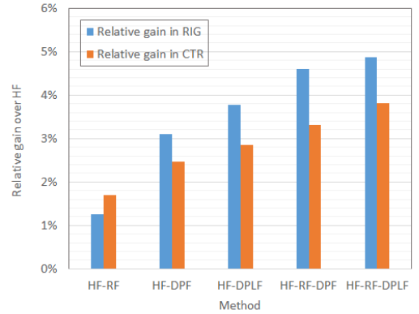
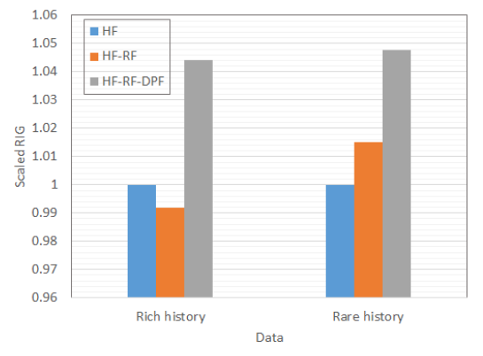
Experimental Result
Overall Performance
Impacts on Ads with Rich v.s. Rare History

Slide 20
Experimental Result
Effects of User Desires on Different Ads Categories
Effects of Combinations over Desire Patterns

Slide 21
Outline
Introduction
Method
Experiments
Conclusion

Slide 22
Conclusion
Explores a new way for computational advertising to embrace the traditional psychological analysis to enhance the computational advertising
Answering “why” users click search ads by exploring user psychological desire according to consumer behavior analysis and Maslow’s desire theory.
Construct novel features for both ads and users based on our definition on psychological desire and incorporate them into the learning framework of click prediction.

